Slide 1

IoTtalk: A Platform for IoT Applications Quick Development
Dr. Yun-Wei Lin NYCU

Slide 2
Outline
The Evolution of Communication
What and Why is IoTtalk?
How to deploy?
Device Connections with IoTtalk
IoTtalk System Architecture
Web-based IoT Applications
Conclusion

Slide 3
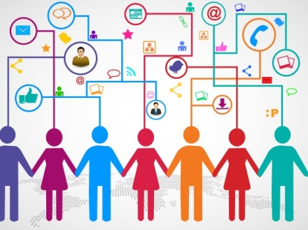
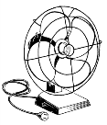
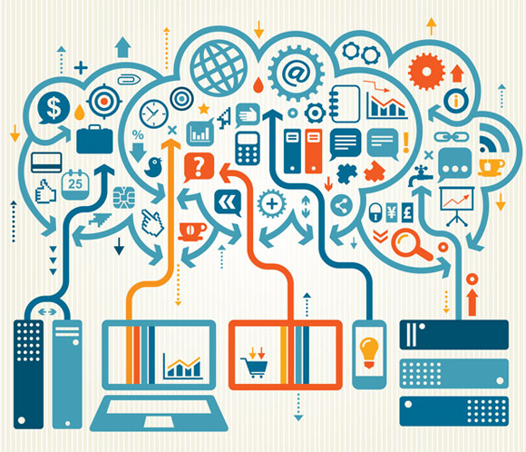





The Evolution of Communication
H2H
A humans talks to the other humans.
H2M
A human directly controls the machines.
M2M
A machine automatically controls the other machines.
The human talks to the other humans.
The human manipulates the machine himself.
Machines have logic or intelligence to manipulate other machines. That is, IoT devices can talk to each other, IoTtalk!

Slide 4
What is IoTtalk?
IoTtalk is an IoT device management tool
IoT management concept
Device Feature
The function or capability which an IoT can provide
Device Model
A set of device features
A device model refers to a specific product
Device name
The name of a specific product
An IoT device
Name
For example: Lin’s phone
Model
Smartphone
Feature 1
G-sensor
Feature 2
Mic.
Feature 3
Display
⁞
⁞

Slide 5
Why is IoTtalk?
Applications can simply develop with lower efforts
Simple and intuitive GUI
Application development without real devices is feasible

Slide 6
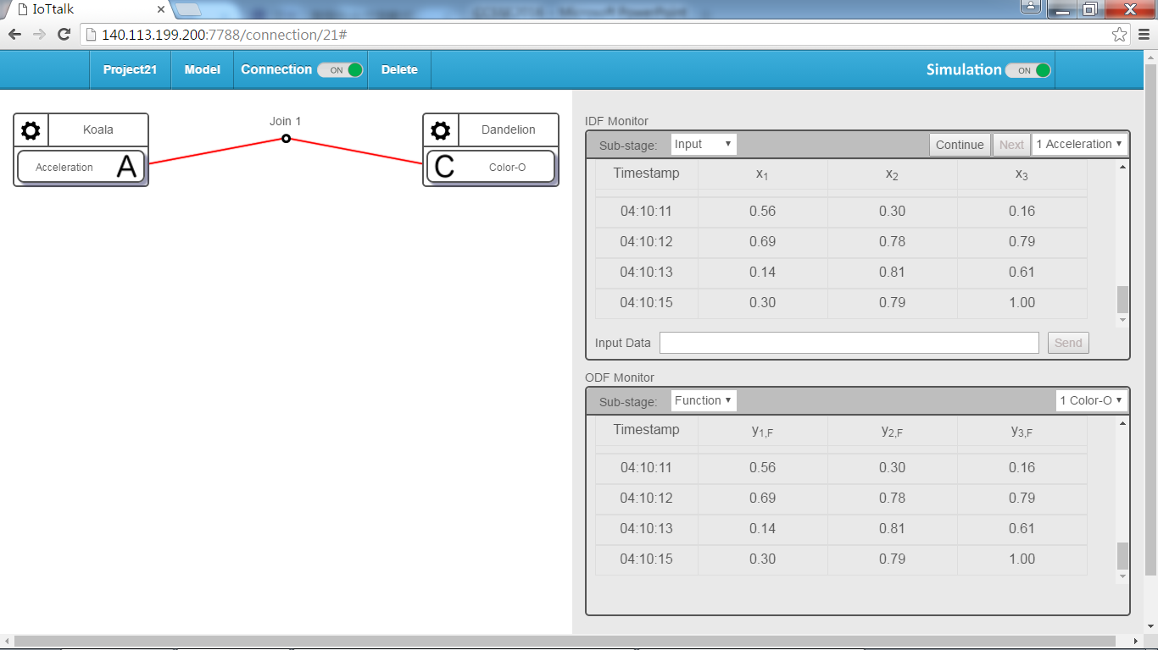
Simple and Intuitive GUI
Connections by intuitional drawing links between IoT devices
Transparently observe the connections between IoT devices
Monitor the transmitting values between IoT devices
Application debugging is more easier

Slide 7



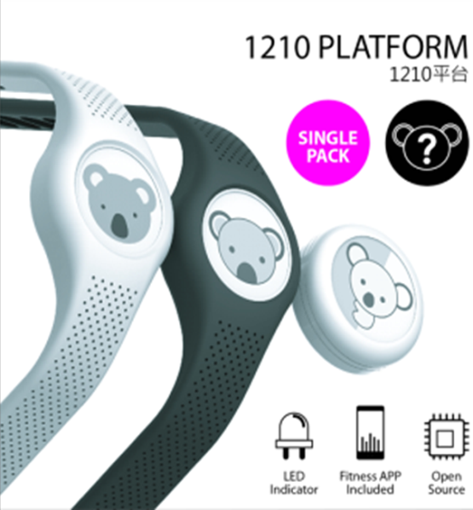
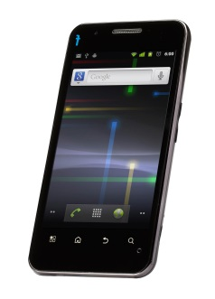
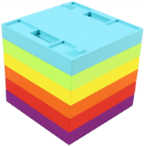
Applications can simply develop with lower efforts
Reusable DF modules
Even they are different IoT devices

Slide 8
Application development without real devices is feasible
Do not need the real devices first to develop applications
The simulator provides the numerical values as inputs

Slide 9
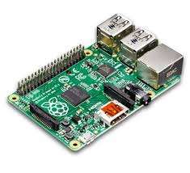
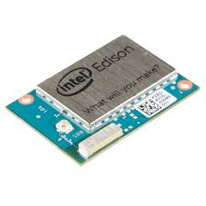

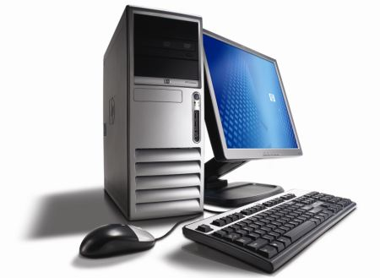
Easy to Deploy and Operate
Intel Edison
Raspberry Pi4
VMs in the Cloud
For example, you can try
https://demo.iottalk.tw
PC server

Slide 10

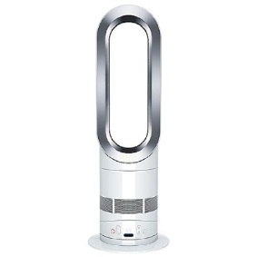
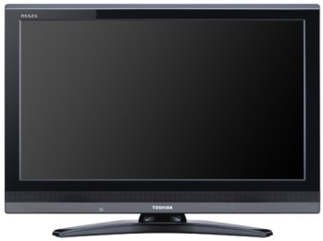
Appliance Connections with IoTtalk
Input Device
Features
Output Device
Features
M_{ic}
1
NA1
L_{um}
D1
D3
A_{cc}
2
NA2
F_{an}
D4
D2
3
NA3
T_{mp}
D5
A_{cc}
4
S_{wh}
D1
Network Application NA1
D3
A_{CC}-IDF Module
L_{UM}-ODF Module
A_{CC}
L_{UM}

Slide 11
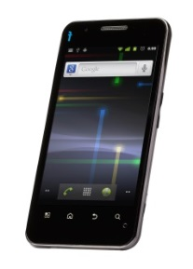
Connection and Mapping Manner
Smartphone
Bulb
A_{CC}
L_{UM}
IoTtalk
Network Application
IDF
module
ODF
module
Service Logic Unit
normalization
scalar
scaling

Slide 12
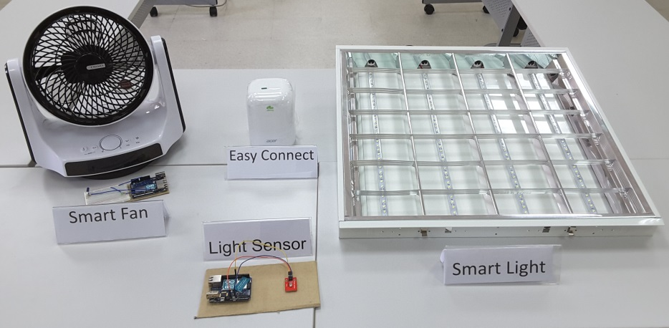
Connect Appliances to IoTtalk

Slide 13
System Architecture
IoT Device
IoTtalk
IDA
IDA: IoT DA
Database
GUI
(Bluetooth/BLE/WiFi/...)
Mobile Device
ORM API
HTTP
DA
HTTP
(WiFi/3G/LTE)
ESM
HTTP
CCM
DAI
DAN
CSM
DA: device application
DAN: DA to Network
DAI: DA to IoT device
IDA: IoT DA

Slide 14
ArduTalk - IoTtalk and Arduino Yun

Slide 15
ArduTalk - IoTtalk and Arduino Yun
Arduino Yun
Wi-Fi AP
ATmega32u4
IoTtalk
IDA: IoT DA
IDA
Database
GUI
Bridge
DA: device application
DAN: DA to Network
DAI: DA to IoT device
IDA: IoT DA
Linino AR 9331
ORM API
HTTP
DA
HTTP
(WiFi)
Execute
HTTP
Config & Connect
DAI
DAN
Comm.

Slide 16

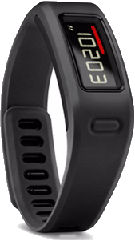
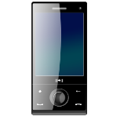
IoTtalk is a network application platform to simplify the network application development.
Cloud
NA1
NA2
IoTtalk
IoTtalk
API

Slide 17
Cloud
If the device is developed under oneM2M, openMTC, or AllJoyn, these IoT platforms will provide APIs for the user to develop network application for the device.
NA1
NA2
API
OneM2M
API

Slide 18

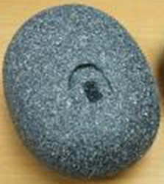
These standards are difficult to interoperate, and the devices cannot easily communicate
Cloud
NA1
NA2
NA3
API
API
OneM2M
AllJoyn

Slide 19
IoTtalk is a network application platform built on top of the above IoT systems to simplify the network application development.
Cloud
IoTtalk
API1
API2
OneM2M
AllJoyn

Slide 20
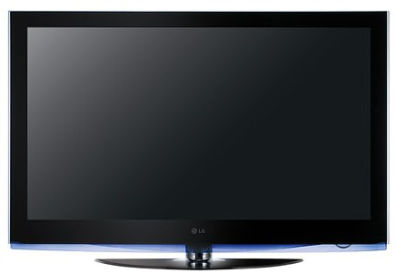
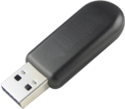
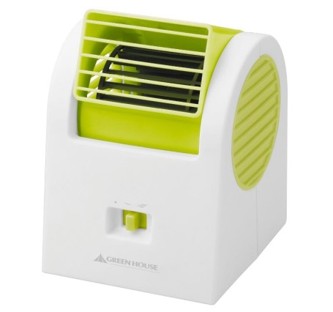
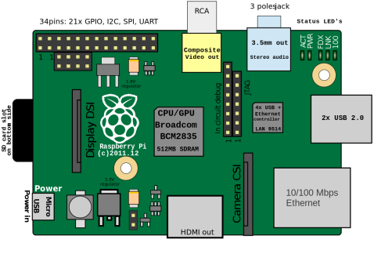

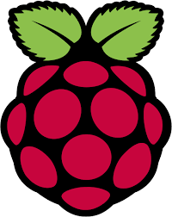
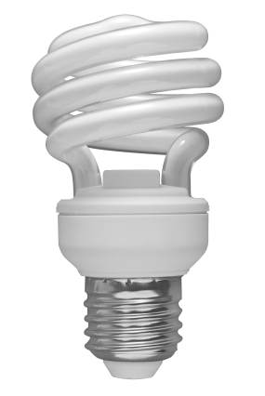
The Smart Home Solution by CHT
Chunghwa Telecom (CHT) provides a smart home solution through a USB dongle and an IoT gateway.
Each appliance is plugged in the USB Wi-Fi dongle for connecting to the IoT gateway.
A user can remote an appliance by its remote APP in the smartphone.
CHT Wi-Fi dongle
(Wi-Fi)
CHT IoT Gateway
CHT Appliance Remote APP
(Wi-Fi)
(Wi-Fi)
Raspberry Pi 3/4
(Wi-Fi)
Smartphone

Slide 21
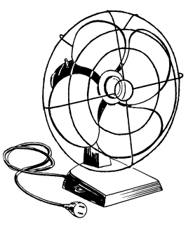
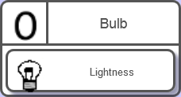
CHT Smart Home with IoTtalk
Cloud
IoTtalk
CHT IoT
Gateway
(Wi-Fi)
Appliances
DB
GUI
Smartphone
Sensors
ESM
(Wi-Fi)
Remote
CSM
CCM
Smartphone
HTTP
WebSocket
CHT APP
Remote
(Wi-Fi)
DA
DAN
DAI
DA:
1. Register/Deregister for appliances/sensors according to notifications
2. Pull commands from the IoTtalk server to CHT home server
3. Receive sensor data then Push them to the IoTtalk server
For example:
Smartphone
CHT-Ctl (Remote)
Join 1
CHT-GW
Remote
CHT IoT Gateway
SW1
Fan-I
Join 2
Fan-O
SW2
CHT-GW is the DM.
Each feature refers an appliance.
SW3
MorSensor1
Temperature

Slide 22
IoTtalk with Machine Learning
GridSearch

Slide 23
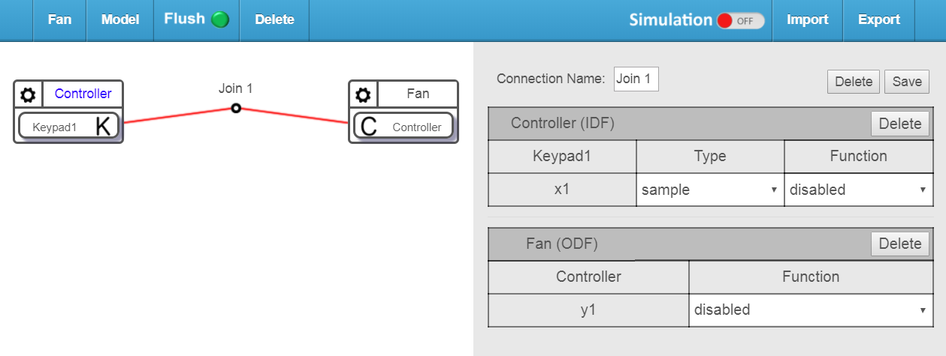

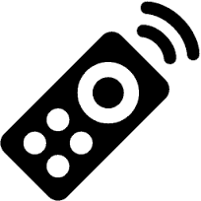
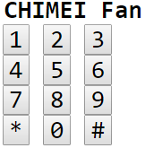
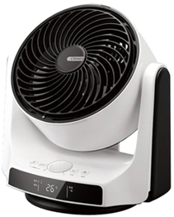

Fan Control using IoTtalk
Click the device features of the two devices to create a link between them.
Then, the user controls the Fan using Keypad through IoTtalk
Remote
Fan
4
5
Remote

Slide 24
Smart Fan using IoTtalk with Machine Learning
Insert a machine learning device and sensors between Keypad and Fan.
Machine learning device

Slide 25
Conclusion
IoTtalk is an IoT device management tool
Easy to deploy and operate
Easy to develop applications - simply connect IDFs and ODFs
Transparently observe the connections between IoT devices
Monitor the transmitting values between IoT devices
Application debugging is more easier

